Slide 1
Best Process Map Ever INTRODUCTION Ted Twaalfhoven founder & CEO

Slide 2
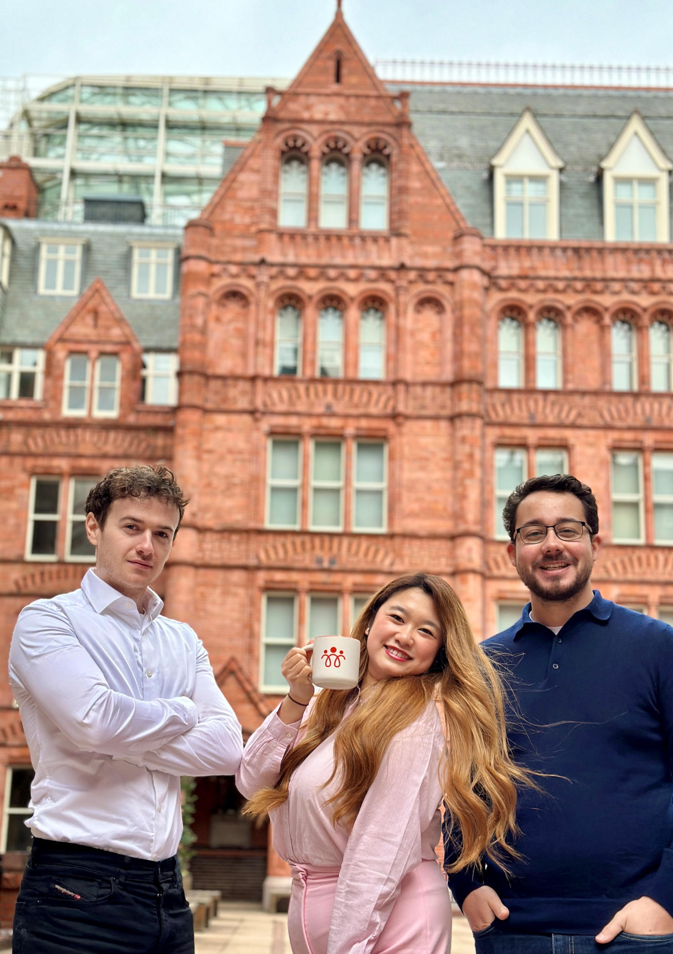
The UK Team Waterhouse Square, London dean@engageprocess.com winola@engageprocess.com kyle@engageprocess.com
Dean – Winola - Kyle

Slide 3
Organizations see increasing number of projects
EFFICIENCY
____________
Cost reductions
Self Service
Cheaper products
Inflationary costs
Do more with team
EFFECTIVENESS
____________
Shorter lead times
First time right
eLearning /handbook
Outsourcing
Suppliers
COMPLIANCE
____________
Risk management
Privacy, GDPR
Meta Data
Certifications
Financial Control
TRANSFORMATION
____________
Dig. Transformation
Service Redesign
Single Access Point
Data management
Robotics. AI ?
Conflicting goals?
Central control?
Spread leadership?
Extra budget?
Impact on work?
How does it help me?
Are my ideas welcome?
Whom do I report to?
Which priority?
Time spent?
Are we still servicing the customer?

Slide 4
From project driven to process driven
PROJECT
PROJECT
PROJECT
PROJECT
PROJECT
FOUNDATION of PROCESSES
PRIMARY WORK
Notes:
From project driven to process driven

Slide 5
Central role for process management
Compliancy
& Risk Management
Projects up-to-date when changes happen
In-Control & Agile
1
Cost
Savings
Essential details at the right moment
Bottom-Up & Top-Down
2
Service Redesign
Impact Reports
Processes
In control
3
Synergy between projects
Faster & Cheaper
IT Systems
Robotic/ RPA
4
Organisation keeps its Focus on primary services
Employees see issues in perspective of work
Data / Information
5
Roles & organization / Outsourcing
People driven change
6

Slide 6
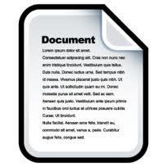
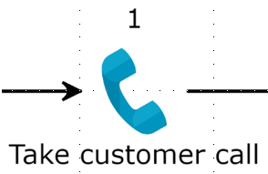
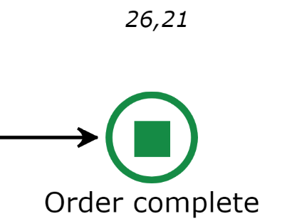
What is our process?
THE HIDDEN FACTORY
Don’t worry! I work here a long time already and know what to do !
In human centric organizations:
Task instructions correct for only 60-90% in each individual task
Sum of exceptions is often greater than the number in the happy flow

Slide 7
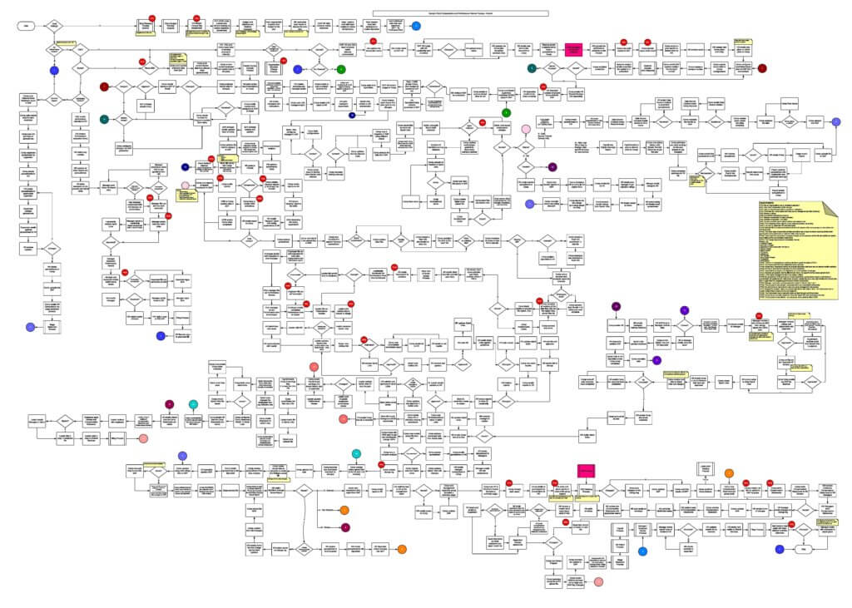
How do we deal with all relevant detail
at that MOMENT, for that PERSON, in right CONTEXT
Empowering the team and the discussion (and not confusing them)
The
WORST process map ever

Slide 8
The Engage Process Platform
Designed for people empowerment
Workshop
1 single screen
Intuitive icons
SYNTAX
Automatic
Process design
Tables
Central database for data fields
Detail Show/Hide®
Swim Lanes SwitchView®
Evaluate/
Calculate
Results & Awareness
Value-Added
or not
Findings
From suggestions
to Actions
Handbook
Instant
StepView® details
Feedback
Continuous improvement
Reports
Create, save & run Reports (GDPR, Risk, Efficiency, etc.)

Slide 9
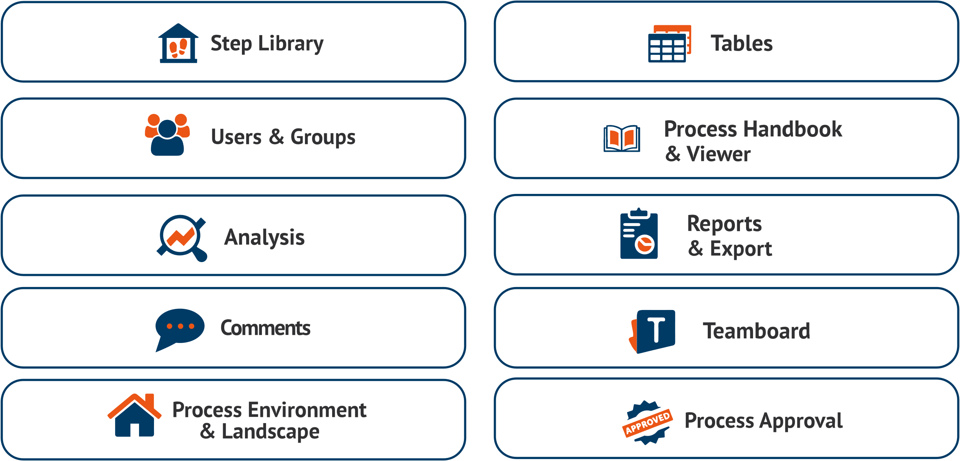
CONFIGURATIONS: 1 platform for multiple goals.
MODULES
THEMES / GOALS
Cost Savings
Compliance / GDPR
Cost Savings
Compliance / GDPR
Service Redesign
Service Redesign
Certification
Process Handbook
& Viewer
Certification
Process Handbook
& Viewer
Process Handbook
& Viewer
Automation / Robotics
Automation / Robotics
Identity Access
Identity Access
Benefits Realisation
Handbook, Knowledge Base
Benefits Realisation
Handbook, Knowledge Base
Merger / Outsourcing
Operational Excellence
Merger / Outsourcing
Operational Excellence
PROCESS PLATFORM

Slide 10
RE-INTRODUCTION
On-site or remote for your organization.
free of charge
TEAM DISCUSSION of 1,5 – 2 hours
Role of Process Management
Functions of Engage Process
Cost evaluations, GRC / risk management, Reporting, hand-books etc
Next possible steps for your organisation
➔ Book via your account manager. winola@engageprocess.com
JOIN OUR
OPEN USER TRAINING
You will learn to map processes and navigate the key functions of Engage Process through practical exercises. This is a remote training, running 2x ½ day on Monday, March 4th and Wednesday, March 6th from 9:00 - 12:00am.
Cost is £250 per person.
Register via training@engageprocess.com.

