Slide 1
Socitm
Engage Process
Laurence Allen
Country Manager, UK
People | Process | Results

Slide 2















400+ Customers globally
80+ in UK , Offices in NL and UK
Service Redesign and Cost Savings
IT Change Programme
Local Government Reorganisation
1000+ processes
in 2 years
Identifying efficiences
HS2 Organisational Efficiency
People Driven Change
Process Improvement
New Housing Management System
Customer service improvement
Voids Processes
ASC Redesign & Digital Change
Customer Experience
Continuous Improvement
Adult Services

Slide 3
Mission of Engage Process
To involve and empower
subject matter experts
in exploring their work
to support the objectives of the organisation

Slide 4
The power of process workshops
Visibility
Role Clarity
Knowledge capture
Buy-in
Root-cause analysis
Collaboration
Seeing the process end-to-end
Transformation Thinking
Customer Experience
Improve processes with those who know it best: frontline colleagues and service experts.
Engaging teams for input, feedback, and creating a single view of change.
Notes:
The people doing the work can explain what happens. Managers can explain why. Technology teams can understand the implications. And transformation teams can connect it back to the change you're trying to achieve.
Visibility See how work actually happens in practice, not how it ‘should’ happen according to documentation.
Role Clarity Identify responsibilities and accurately quantify handoffs, duplication, and associated process wastage.
Knowledge capture Turn what’s in people’s heads into a documented, shareable process
Buy-in People support change they helped design. Evidence over assumptions
Root-cause analysis Fix the real problem, not just the symptoms
Collaboration Bring teams together around a shared goal, improve cross-team understanding and encourage collaboration
Seeing the whole end-to-end
Transformation Thinking Encourage participants (typically business colleagues) to think in a transformation and continuous improvement-oriented way about what they do and why they do it
Customer Experience Put the customer at the heart of process change.

Slide 5
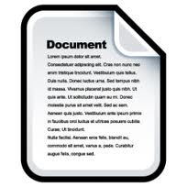

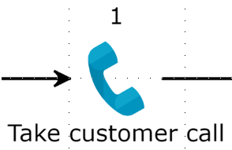
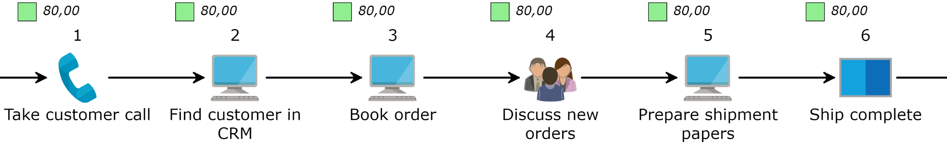
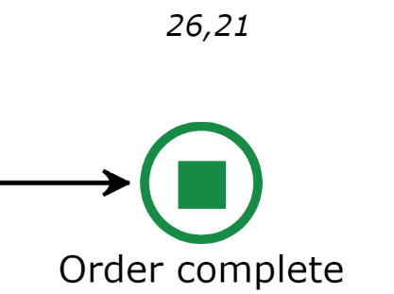
What is our process?
The hidden factory
In human centric organisations:
Task instructions
60-90% correct in each individual task
Sum of exceptions is often greater than the number in the happy flow
Notes:
Building upon previous slide on value of process workshops.
Defined as the workarounds, spreadsheets and shadow processes that exist when the “happy path” or standard process doesn’t quite work.
This gap is missed when organisations miss staff engagement. It presents:
Risk as regulation and inspections tighten
Gaps in blueprints for automation and AI to replicate
Loss of knowledge when people leave or change roles

Slide 6
Process management brings synergy
1
Assessing impact with visibility and data
Service Design and Improvement
Necessary detail at the right place
2
Cost Savings
Regulations and Compliance
3
Synergy for all projects quicker & cheaper
Processes
Operational Control
SME participation for people-driven change
4
New or Legacy
IT Systems
Data
Architecture Information
Overview ➔ Insights ➔ Action
Improved User Experience
5
Notes:
Harminisation of services etc

Slide 7

PKC
PERTH & KINROSS COUNCIL
Process First, AI Second.
How PKC is turning responsible AI adoption into reusable organisational capability.
PRESENTER
Chris Wright
IT Team Leader, AI & Automation

Slide 8
“
How many of you, if asked tomorrow by your Chief Executive to prove your AI programme is working, could answer that question with evidence rather than anecdote?

Slide 9
THE PROBLEM WITH AI WITHOUT PROCESS
The standard AI deployment pattern
STEP ONE
STEP TWO
STEP THREE
Procure
Deploy
Hope
?
Where is the baseline?

Slide 10
THE PKC DECISION
No material service deployment without an understood process, an accountable owner and a measurement plan. For PKC Notes, process baselining and governance readiness are formal gates before controlled live use.
Not an optional extra added afterwards. The gate.

Slide 11
THE PKC METHODOLOGY
Five steps. Each one matters.
01
02
03
04
05
Map As-Is
Model To-Be
Capture Baseline
Deploy Into Known Process
Validate With Actuals
Document every step, time, and volume before a single licence is allocated.
Map the AI-augmented workflow. The delta is your forecast saving.
Fix the as-is data as the reference point. It does not change.
Track real usage against the baseline. The forecast holds or refines.
Introduce AI into a mapped process — and inform prompt architecture.
Throughout: named service ownership · governance by design · human review · controlled onboarding
Baseline before go-live, measure against it, monitor continuously.

Slide 12
CASE STUDY
The first deployment through the full sequence
AS-IS PROCESS
WITH PKC NOTES
Manual notetaking
Fully present, then review
The officer listens, assesses, and writes at once during the client meeting. Afterwards: write-up, formatting, and distribution into case management systems — timed and documented at baseline.
Our Azure-native transcription platform runs in the background . The officer stays fully in the conversation. A structured draft is ready at the end to review, approve, and distribute.
87 mins
1,200–1,800
1,720–2,610
Saved per meeting
Meetings per year
Forecast hours saved annually

Slide 13
BEYOND THE HOURS SAVED
The benefits that make services ask for the tool
01
02
03
04
Officer Fully Present
Immediate Record
Consistent Structure
Staff Confidence
No longer listening and writing at once — fully in the conversation, which changes the quality of the interaction and the outcomes.
Available within minutes rather than 48 hours, removing duplication of work from memory.
The same output regardless of time pressure or individual writing style — vital for compliance and defensibility.
Voluntary adoption, wellbeing, and accessibility for neurodiverse staff built into the way the tool works.
Professional judgement remains human Every output is a draft. The responsible officer checks, corrects and approves it before it becomes part of the official record.

Slide 14
AT PROGRAMME SCALE
What we have learned
Structured professional conversations work better than rapid, multi-speaker updates.
Service-specific templates and context matter more than a generic prompt.
Onboarding is an organisational-change process, not simply granting access.
Where the output is not reliable or valuable enough, refine the use case or stop.

Slide 15
AT PROGRAMME SCALE
Three unlocks at programme scale
01
02
03
Evidence that can survive scrutiny
A repeatable adoption model
A reusable Council capability
Clear distinction between forecast, capacity release, actual benefit and cashable saving.
Intake, baseline, prioritisation, governance, configuration, training, controlled live use and evaluation.
Speech, document intelligence, retrieval, audit, governance and evaluation components that can support future services, not just additional PKC Notes deployments.

Slide 16
THE SCALE THIS OPERATES AT
A live, full-scale programme — not a proof of concept
600
90%
2.9 hrs
Copilot licences
Monthly active use
Saved per person, per week
Across all service areas
Allowing for leave and ansence
Conservative midpoint analysis
68 %
0
65 %
Survey Response Rate
Cancellation requests
Voluntary AI literacy enrolment
78% call it essential to their work
Across the entire deployment
vs 20–30% sector average

Slide 17
“
How many of you, if asked tomorrow by your Chief Executive to prove your AI programme is working, could answer that question with evidence rather than anecdote?
The answer starts with process.
Notes:
Process gives you the baseline.
Governance gives you permission to scale.
Ownership turns capacity into value.
Evidence tells you whether it worked.

