Slide 1
Effective process management
Ted Twaalfhoven founder & CEO

Slide 2














350+ Customers world wide. Offices in Schiphol & London
Change Programme
Housing Applications Implementation
RPA,
1000 processes in 2yr
Identifying efficiencies
HS2 Organisational Efficiency
People Driven Change
Process Improvement
Service Redesign & Cost Savings
Lean & Continuous Improvement
Customer service improvement
Automation
Change Programme
ASC redesign & digital change

Slide 3
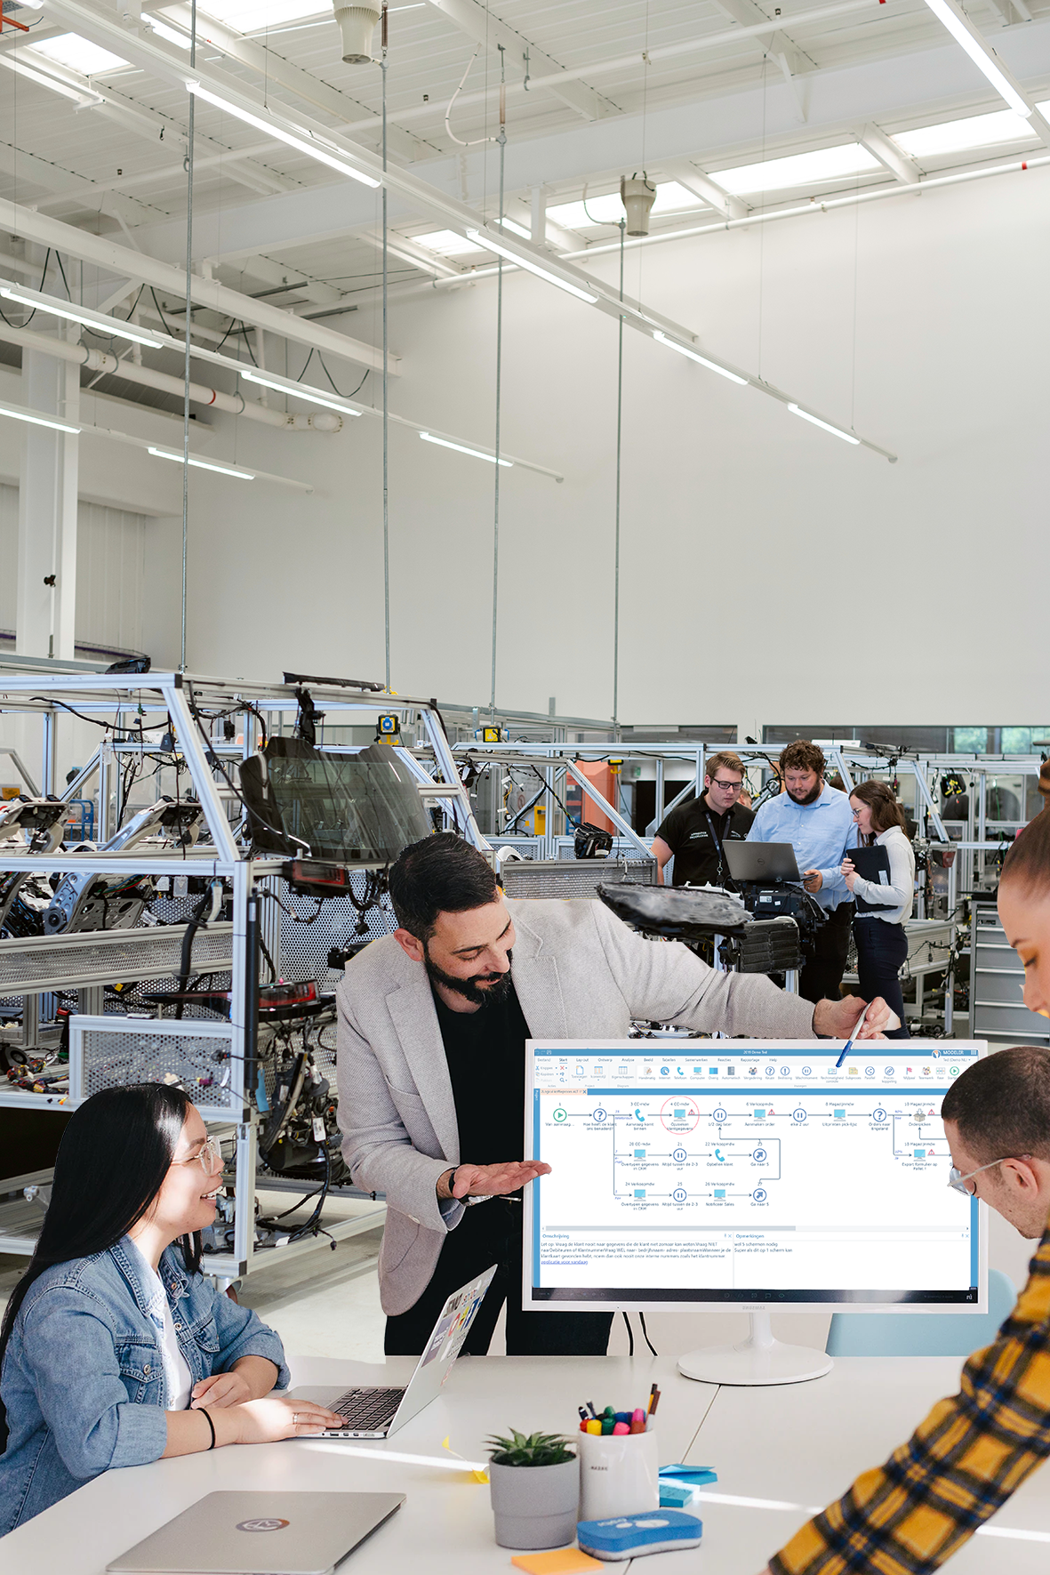
MISSION
Involve operational staff in discussing their work and mapping processes.
To reach an “in-control” situation.
Cost reduction programs, Digital Transformation, GDPR, Compliance/Certification, outsourcing, automation, etc.
Can process maps only be created, altered and read by management and specialists?
Or do they enable the operational staff; towards people driven change?

Slide 4
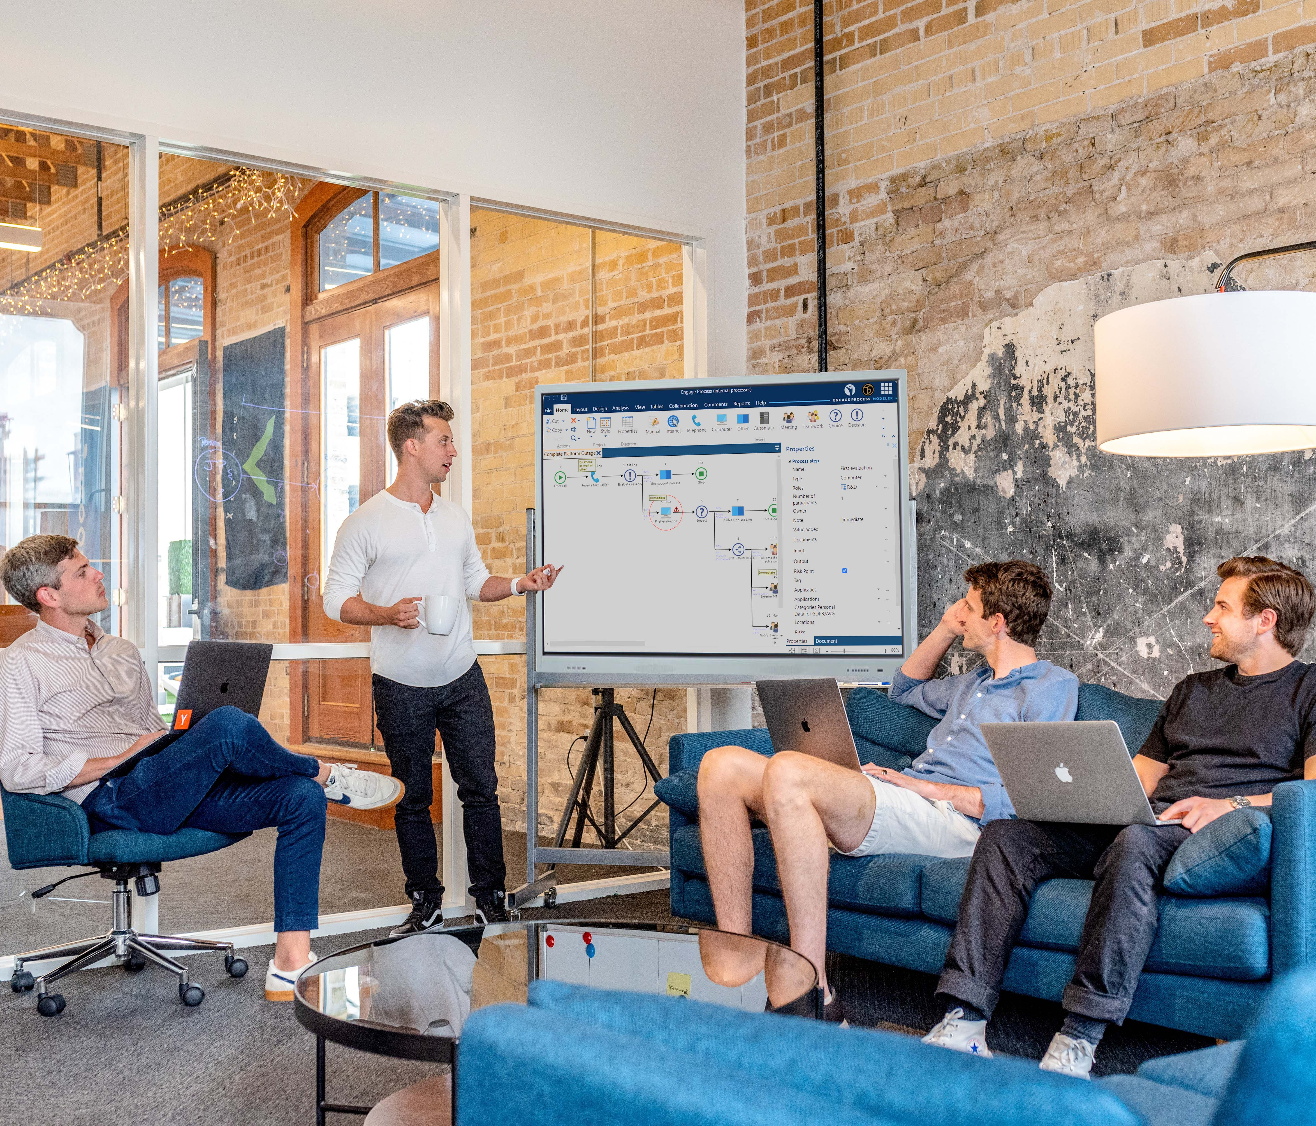
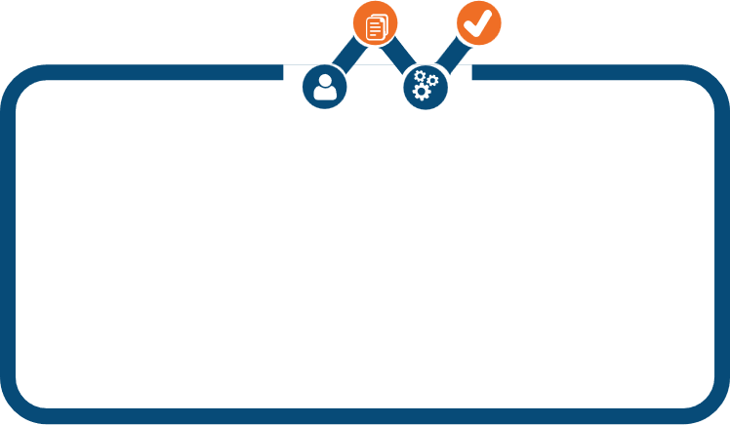




MISSION: in line with key process management principles
(Lean, OpEx, WCM, TOC, 6Ʃ, Kaizen, etc.)
2. Customer
Journey
3. Facts and Data
1. Team
5. Continuous
Improvement
4. Improvements

Slide 5

Organizations see increasing number of projects
EFFICIENCY
____________
Cost reduction
Self Service
Cheaper products
Inflationary costs
Do more with team
EFFECTIVENESS
____________
Reduce lead times
First time right
eLearning /handbook
Outsourcing
Suppliers
COMPLIANCE
____________
Risk management
Privacy, GDPR
Meta Data
Certifications
Financial Control
TRANSFORMATION
____________
Digital Transformation
Service Redesign
Single Access Point
Data management
Robotics. AI ?
Goals conflicting?
Central Control?
Spread leadership?
Extra budget?
Impact on work?
How does it help me?
Are my ideas welcome?
Whom do I report to?
Which priority?
Time spent?
Are we still servicing the customer?

Slide 6
PROJECT
From project driven to process driven
PROJECT
PROJECT
PROJECT
PROJECT
FOUNDATION of PROCESSES
PRIMARY WORK
Notes:
From project driven to process driven

Slide 7







Central role for process management
Compliancy
&
Risk Management
Projects up-to-date when changes happen
In-Control & Agile
1
Cost
Savings
Essential details at the right moment
Bottom-Up & Top-Down
2
Service Redesign
Impact Reports
Processes
In control
3
Synergy between projects
All projects Faster & Cheaper
IT Systems
Robotic/ RPA
4
Organisation keeps its Focus on primary services
Employees see issues in perspective of work
Data /
Information
5
Roles & organization / Outsourcing
People driven change
6

Slide 8
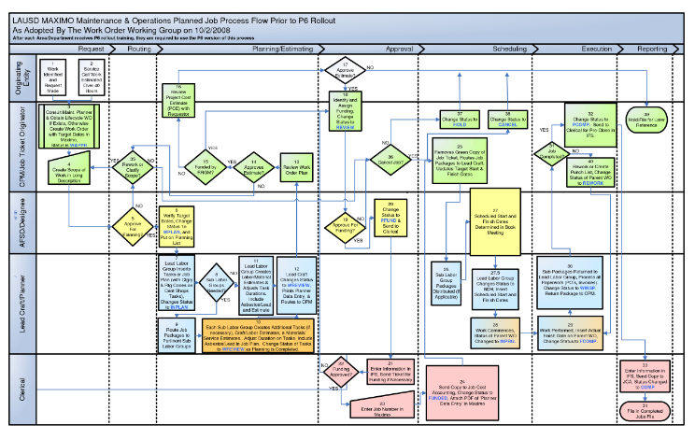
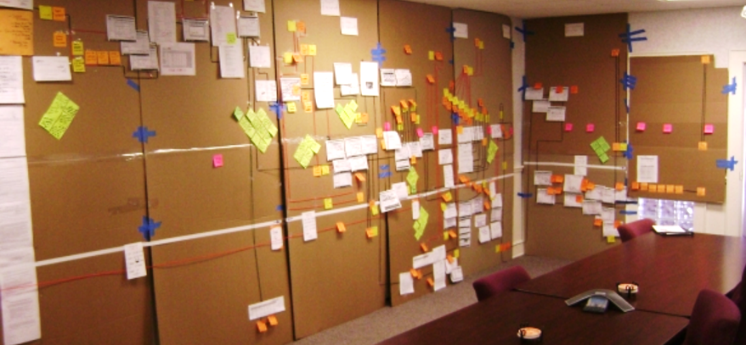


How do we discuss processes?
High engagement
BUT: limited depth in discussion
Single view
difficult to understand
Not read…….
Task instructions instead of process overview
Documentation
Discussion & exploration
Notes:
High engagement. No depth in discussion

Slide 9
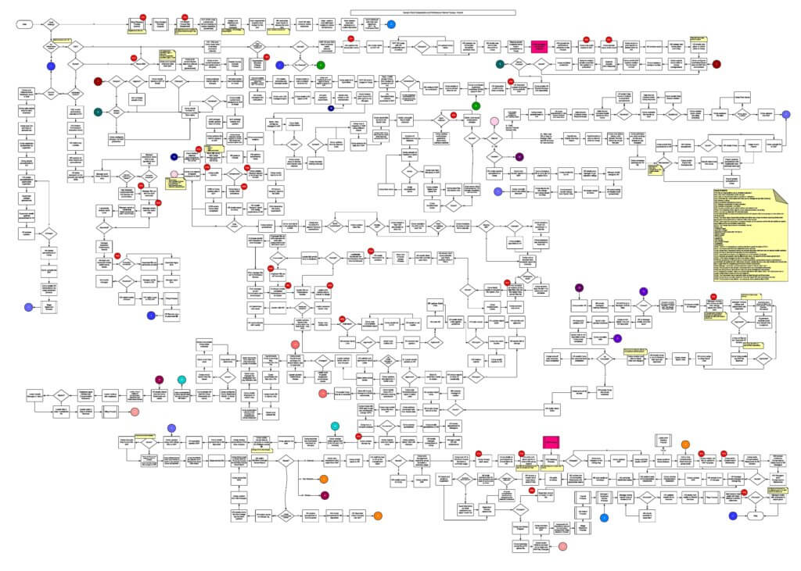
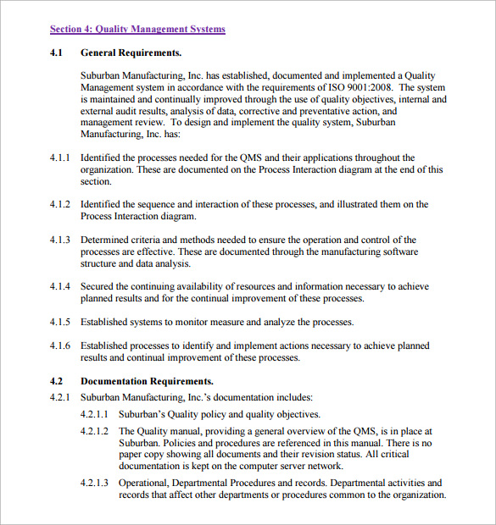
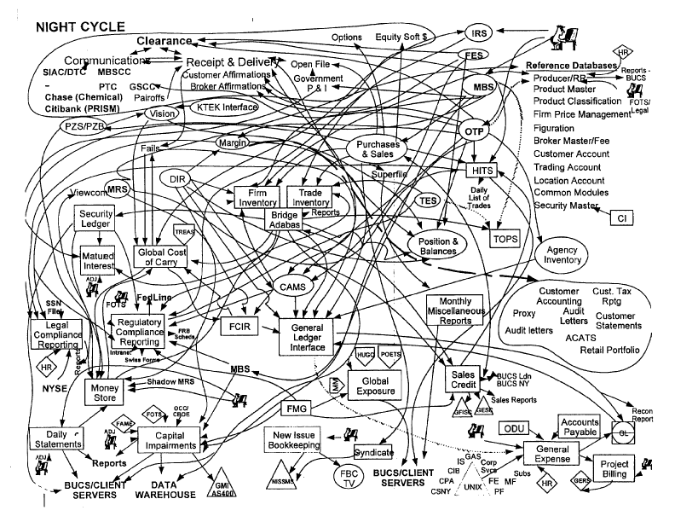
HOW DEAL WITH ALL THE DETAIL ?
Detail that is relevant at
that MOMENT, for that PERSON, in right CONTEXT
Empowering the team (and not confusing them)

Slide 10
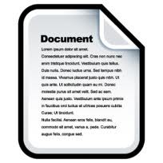


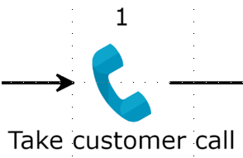
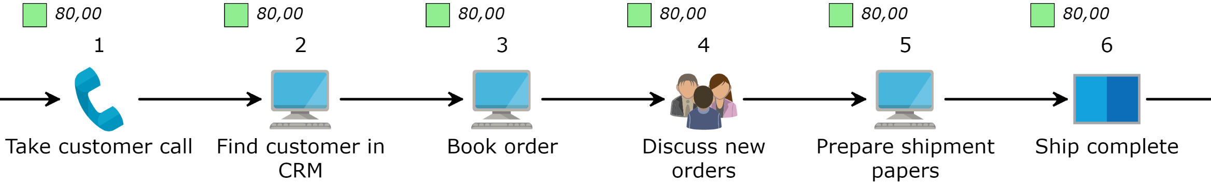
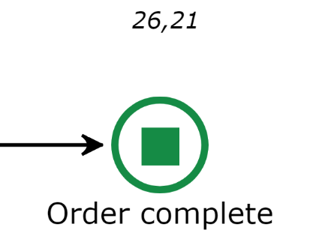
What is our process?
THE HIDDEN FACTORY
Don’t worry!
I work here a long time already and know what to do !
In human centric organizations:
Task instructions correct
for only 60-90% in each individual task
Sum of exceptions is often greater than the number in the happy flow

Slide 11
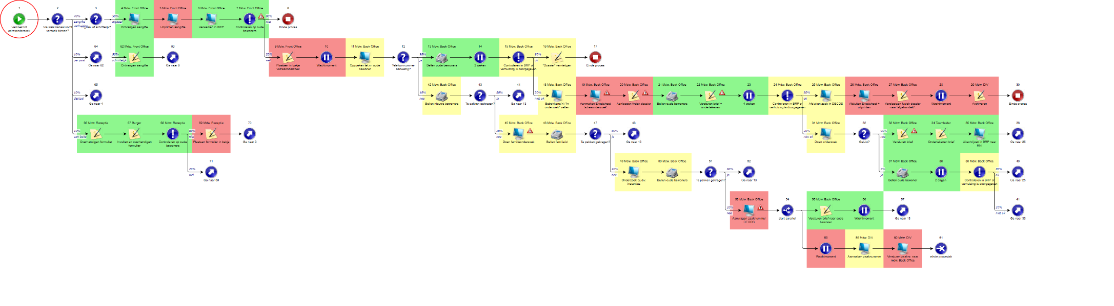
Transformation project: City of Stichtse Vecht (NL)
Details of exceptions must be known

Slide 12
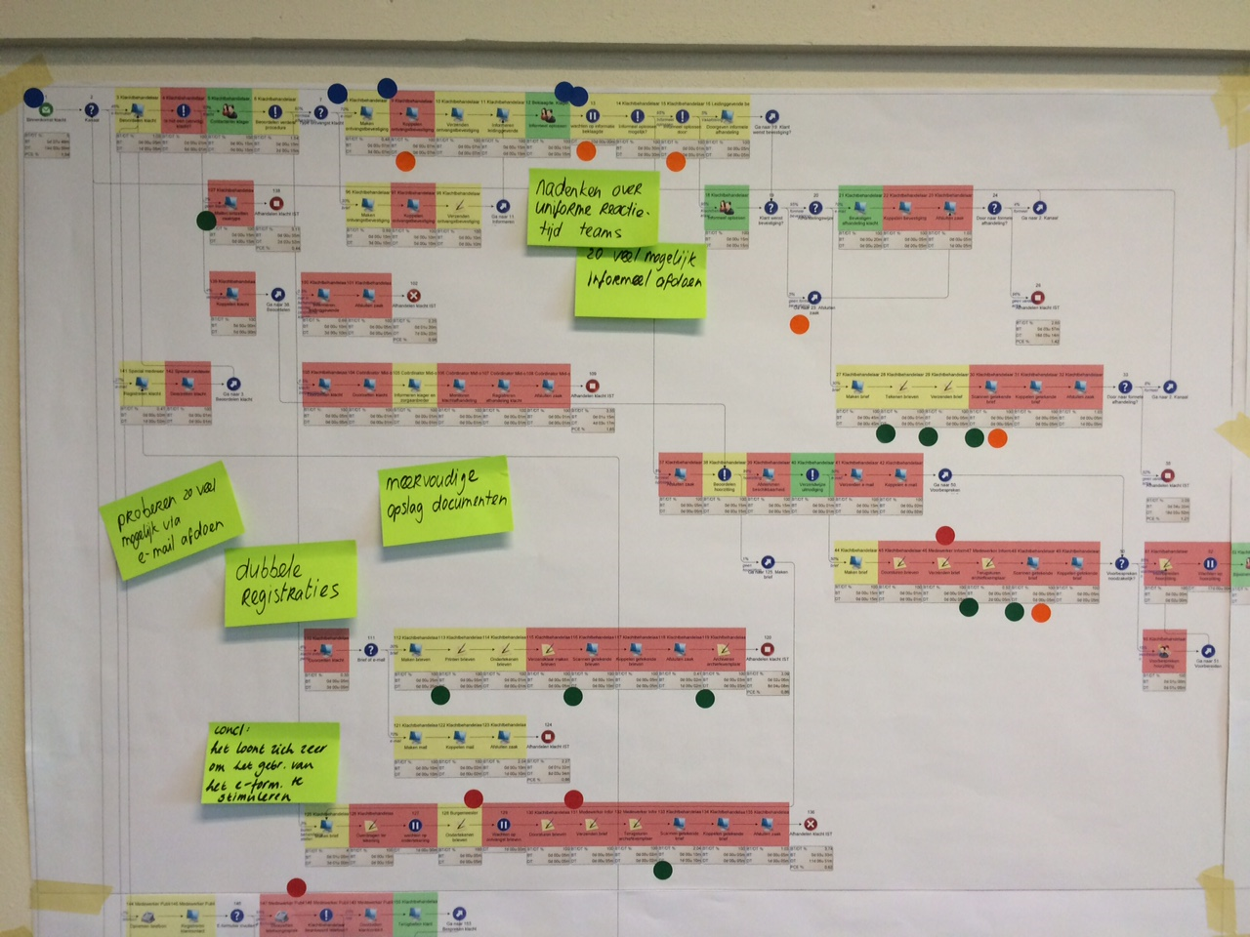
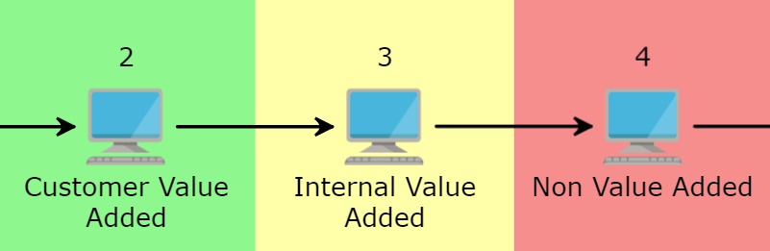
Building Self Service in complaints process; city of Venlo (NL)
Team involvement: first explore & improve
Team scored each activity in current situation

Slide 13
The Engage Process Platform
Designed for people empowerment
Workshop
1 single screen
Intuitive icons
Automatic
Process design
Tables
Central database for data fields
Detail
Show/Hide®
Swim Lanes
SwitchView®
Evaluate/
Calculate
Results & Awareness
Value-Added
or not
Findings
From suggestions
to Actions
Handbook
Instant
StepView® details
Feedback
Continuous improvement
Reports
Create, save & run Reports (GDPR, Risk, Efficiency, etc.)
SaaS – Instantly up and running

Slide 14
Engage Process Platform
Workshop
Explore
Discuss
Improve
Enrich
Layout
Browser based process handbook Real-time from Modeler
“Scrumboard” for flexible tasks
Modeler
Viewer
Teamboard
Brainstorm
Feedback
Publisher
Approval
Upload
Findings
Reports
Tables
Knowledge Centre
Autorisation

Slide 15


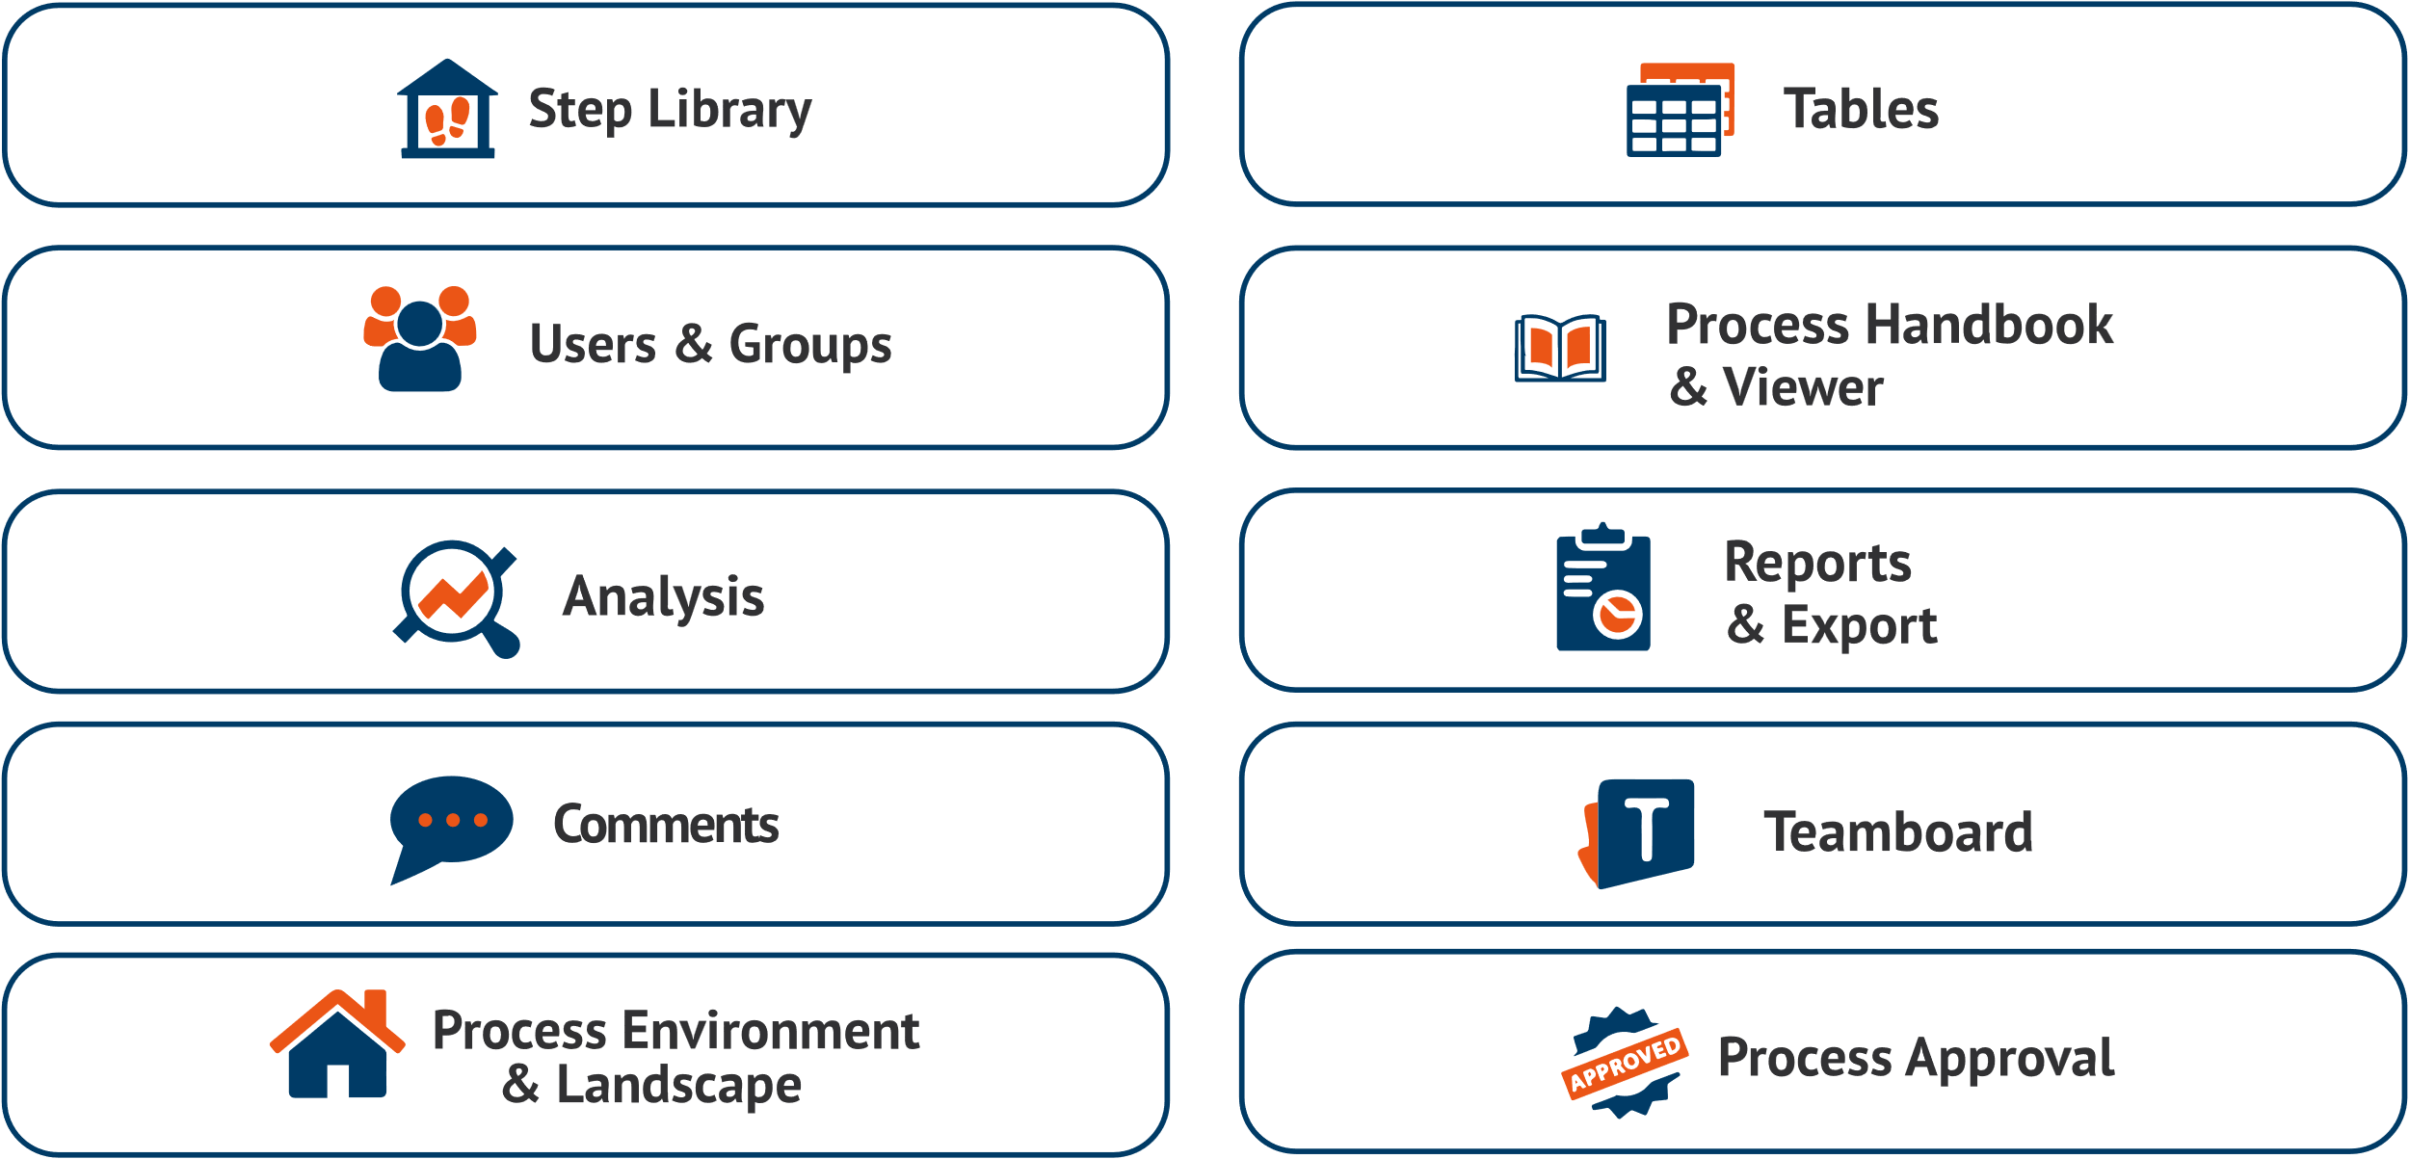








CONFIGURATIONS: Address themes from in-control platform
MODULES
THEMES / GOALS
Cost Savings
Compliance / GDPR
Cost Savings
Compliance / GDPR
Service Redesign
Service Redesign
Certification
Process Handbook
& Viewer
Certification
Process Handbook
& Viewer
Process Handbook
& Viewer
Automation / Robotics
Automation / Robotics
Identity Access
Identity Access
Benefits Realisation
Handbook,
Knowledge Base
Benefits Realisation
Handbook,
Knowledge Base
Merger / Outsourcing
Operational Excellence
Merger / Outsourcing
Operational Excellence
PROCESS PLATFORM

Slide 16

Maturity model – what detail in process map?
Level 1
Level 2
Level 3
Level 4
Level 5
Responsibility
(Process and process steps)
Process scope (Start-Stop, where in process hierarchy)
Tasks and regular exceptions
Supporting tools
KPI’s and other
quality measures
Manual and system instructions
Risks and controls
Improvement cycle
All predictable
exceptions
Input/Output each
process step
Measures
Business rules
Functional design
Theoretical exceptions
All processes
Minimal requirements for publication
Minimum for
‘In control’
Highly frequent or
at risk
Automate / RPA

Slide 17
QUESTIONS?

Slide 18
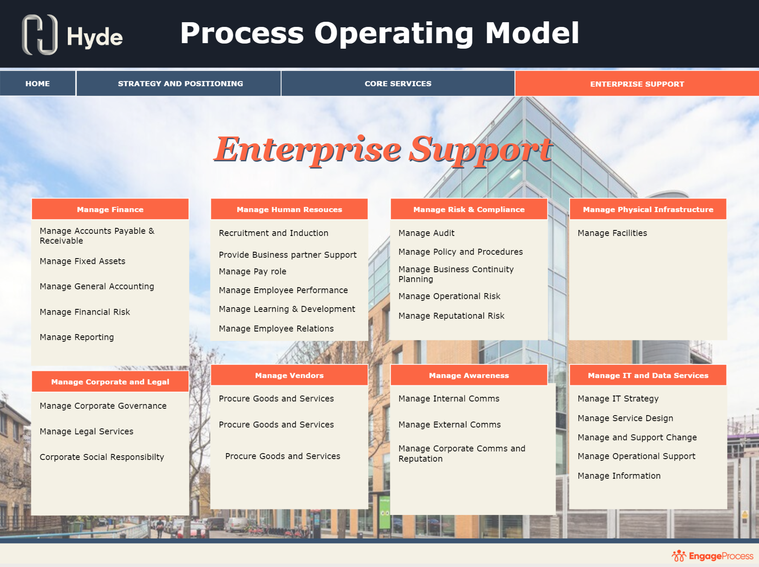
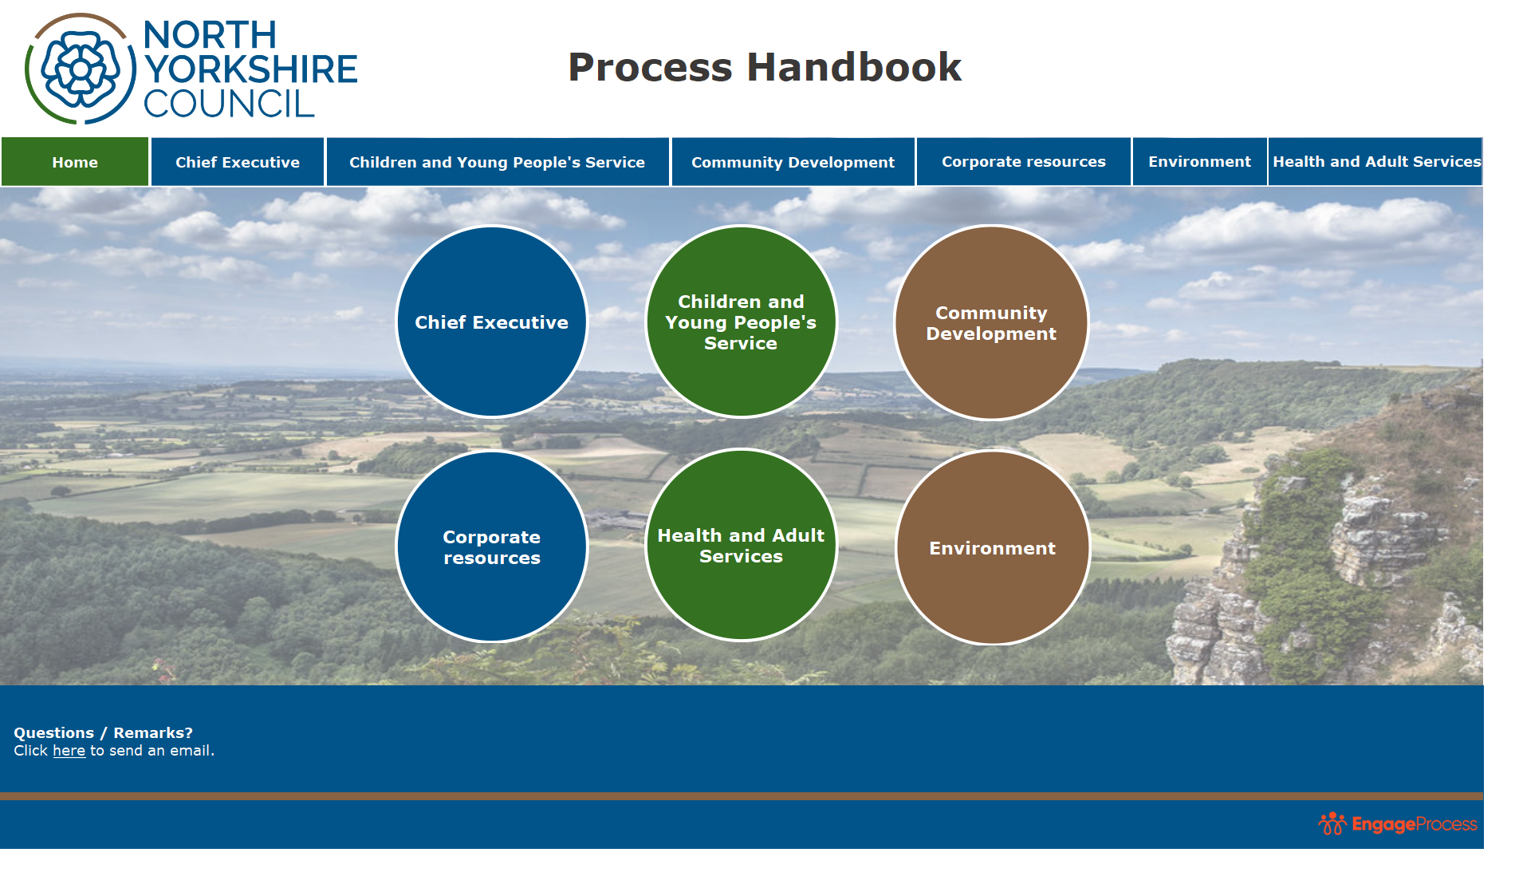
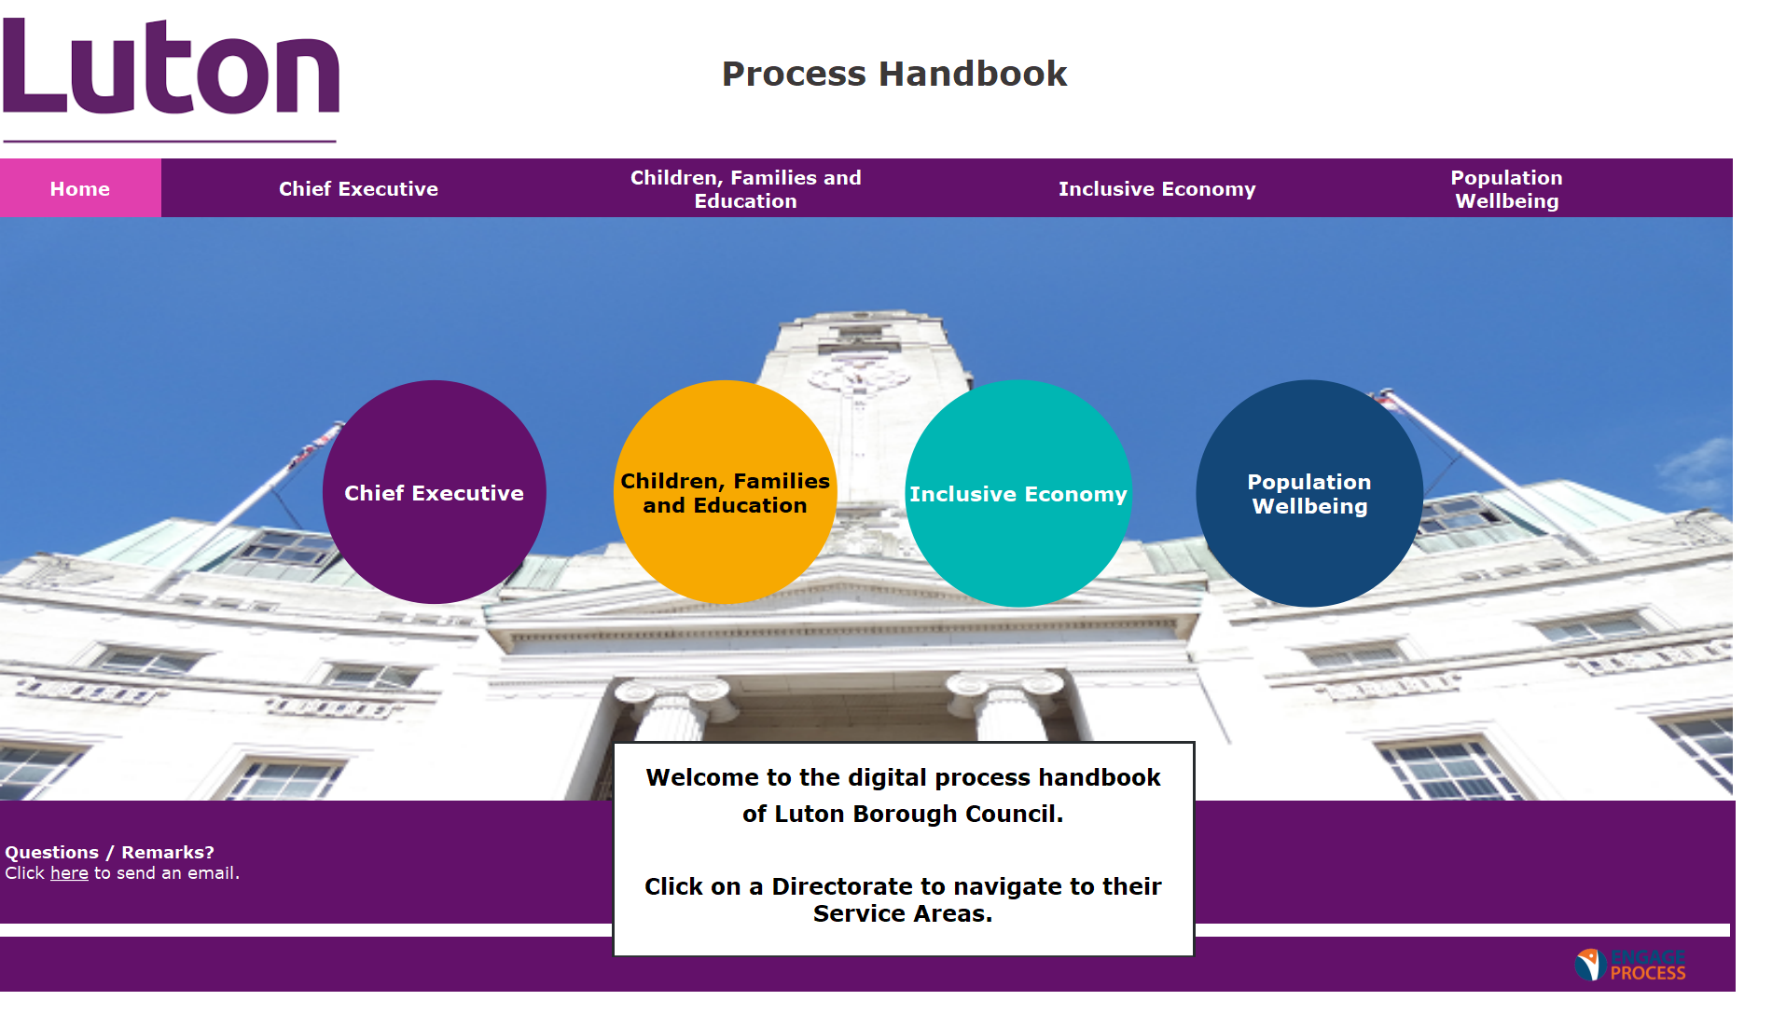
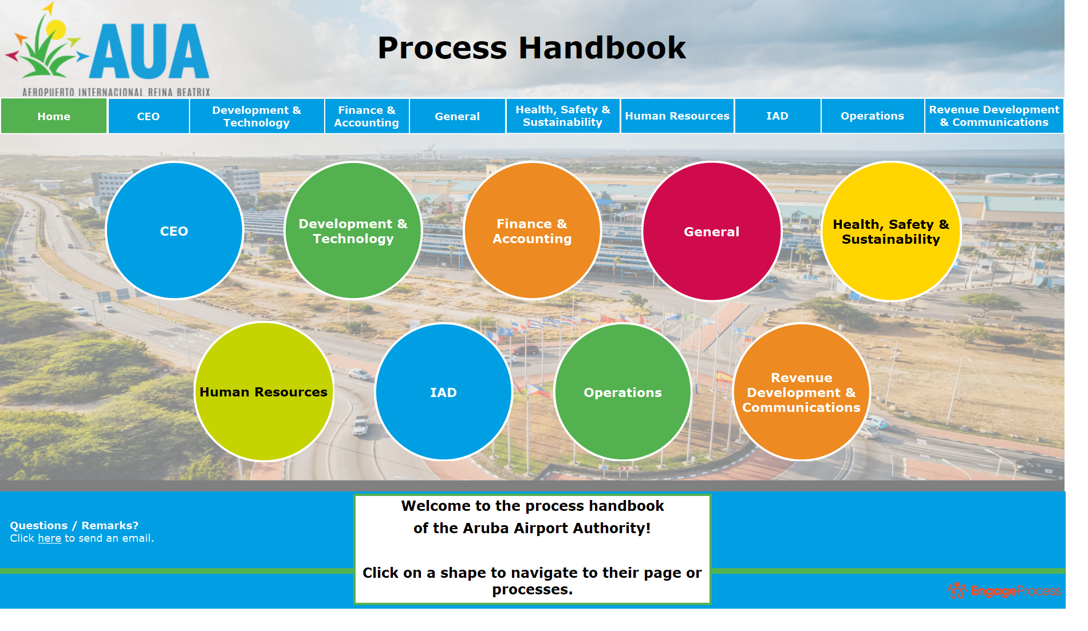
Process handbook design

Slide 19
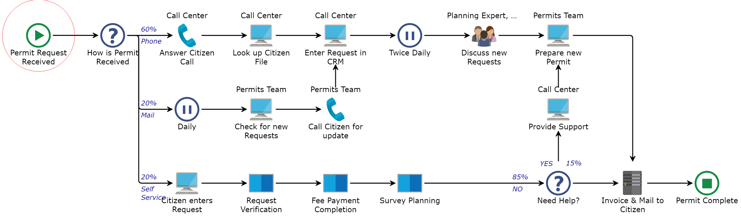
EXAMPLE
Team involvement in Self Service Set-up
Self
Service
Team helped to design the Self-Service.
It is included in the instruction manuals.
They know where to provide support when needed

Slide 24

Gartner: a process exploration tool
(not a BPM tool)
The organization
Brown Paper
PowerPoint
Visio
Generic
Processes
BPM
RPA / Workflow
Mining
IT Departments
Specialist

